Slide 1
Multi-object Recognition on the basis of Vision and manipulation
Kazunori Ohno, Peter Andersson, Zhong Lei, Eijiro Takeuchi, Satoshi Tadokoro
Presented by Edward Venator

Slide 2
Introduction

Slide 3
Background: Object Recognition
SURF – Speeded Up Robust Features
Proposed by Bay, Ess, Tuytelaars, and Van Gool in 2006
Detects and describes features in images, allowing images to be compared
Comparing images allows object detection

Slide 4
Limitations of Vision-Based Object Detection
Objects may be occluded by other objects
Objects are sometimes only recognizable from certain angles
It is difficult for a vision system to separate similar objects that are adjacent in an image.
These problems are all prevalent in human environments.

Slide 5
Manipulation to Enhance Object Recognition
When humans encounter unfamiliar objects, we pick them up to view them from different angles.
When humans want to see past a movable object, we move the object.
Robotic systems can also benefit from the same actions.

Slide 6
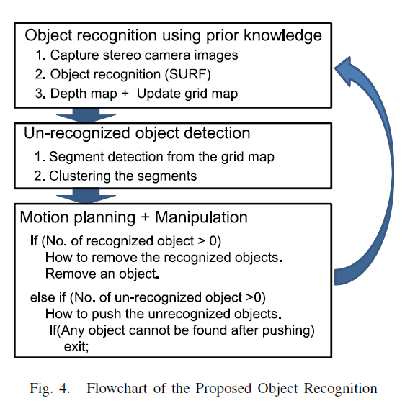
Methods
Using a stereo camera and SURF processing, researchers attempted to recognize objects in a scene
Objects in the scene were classified as recognized or unrecognized.
Recognized objects are removed from the scene.
If there are still unrecognized objects, these objects are moved

Slide 7
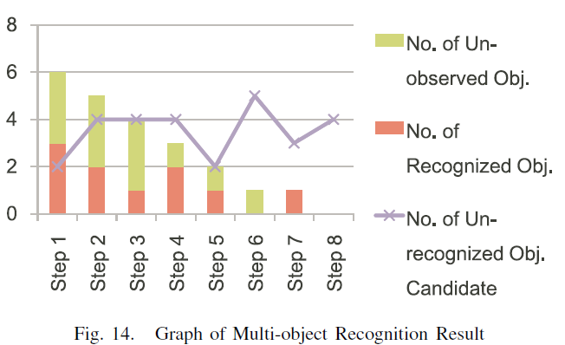
Results
In step 1 of the trial, only 3 of 6 objects were recognized.
After all recognized objects were removed, 2 more objects were recognized.
The final object was manipulated in step 7, and it too was recognized
In step 8, all objects are removed.

